Slide 1


Slide 1
COFFEE SHOP SALES ANALYSIS
INSTITUTE
Institute of Emerging Careers
PROGRAM
Data Analytics cohort 14
TAUGHT BY
Syed Afroz Pasha
PRESENTED BY
Mehwish Azam

Slide 2
Slide 3
AGENDA
WHY THIS DATASET?
DATA OVERVIEW
DASHBOARD DESIGN & COMPONENTS
DASHBOARD VISUALIZATION
OBJECTIVES
Dimension and Fact Tables
KPI Calculations
Key Insights & RECOMMENDATIONS

Slide 3


Slide 5
WHY THIS DATASET ?
Reason for Choosing the Dataset : The dataset from Kaggle is relevant due to its detailed sales transactions, including transaction amounts, product categories, and store locations. This richness makes it suitable for deriving valuable insights.
Relevance and Significance : The dataset is comprehensive, offering a diverse range of records that facilitate an in-depth analysis of sales trends and customer preferences, aiding in strategic decision-making.

Slide 4

Slide 6
DATA OVERVIEW
Key Fields : Key fields include:
Transaction_id : Unique transaction identifier
Transaction_date: Date of sale for time-based analysis
Transaction_time: Time of the transaction
Store_id: Identifies store locations
Store_location: Location of the store
Product_id: Represents products sold
Product_category: Category of the product
Product_type: Type of the product
Product_detail: Detailed description of the product
Transaction_qty: Quantity sold
Unit_price: Price per unit for total sales calculations
These fields provide a complete view of sales performance and customer behavior.
Data Cleaning Steps : Data cleaning involved addressing outliers, handling missing values, and correcting inconsistencies. These steps ensure the reliability of the analysis.

Slide 5


Slide 2
Introduction
Project Title and Objective:
The project is titled "Coffee Shop Sales Analysis." The main objective is to analyze sales performance to identify trends in customer purchasing behavior and provide insights for strategic business decisions.
Background: In the competitive coffee shop industry, understanding sales trends is crucial. This analysis leverages data to optimize strategies and enhance operational efficiency, addressing challenges faced by coffee shops.

Slide 6
Slide 7
Dimension and Fact Tables:
Overview of Tables:
dim_store: Contains details about store locations.
Key Fields: store_id, store_location.
dim_product: Contains product-related details such as category and type.
Key Fields: product_id, product_category, product_type, product_detail.
dim_date: Contains time-related attributes for transaction analysis.
Key Fields: transaction_date, year, month, day, quarter, day_of_week, month_name, weekday_name.
Dimension Tables
fact_sales: Stores sales transaction data and links to dimension tables for analysis.
Key Fields: transaction_id, transaction_date, transaction_time, transaction_qty, unit_price, store_id, product_id.
Foreign Keys:
store_id links to dim_store.
product_id links to dim_product.
transaction_date links to dim_date.
Dimension Tables
Relationships
Dimension Tables (dim_store, dim_product, dim_date) provide context to the sales data.
Fact Table (fact_sales) contains the quantitative sales data and links to dimension tables using foreign keys (store_id, product_id, transaction_date).

Slide 7
Slide 8
KPI Calculations and Visualizations:
Major KPIs: Key KPIs include:
Total Sales: Overall revenue.
Total Orders: Total number of sales transactions.
Total Quantity Sold: Product demand indicator.
Sales by Store Location: Sales performance across different store locations.
Sales by Product Category: Insights into customer preferences.
Sales Analysis by Weekdays and Weekends: Comparing sales performance between weekdays and weekends.
Daily Sales with Average Line; Daily sales trends with a line showing the average sales for comparison.
Top 10 Products by Sales: Identifying the five best-selling products based on total sales.
Sales by Days and Hours: Analysis of sales patterns by day of the week and time of day.
These KPIs help assess the coffee shop's performance.

Slide 8
Slide 11
DASHBOARD DESIGN & COMPONENTS
DESIGN APPROACH
The design is crafted to be clear and communicative, incorporating elements that support strategic decision-making.
VISUAL ELEMENTS
DASHBOARD DESIGN & COMPONENTS
Cards, Slicers, Line, Chart, Pie Chart, Donut chart, Stacked Bar Chart, Stacked Column Chart,
TOOLS USED
Power BI, l & SQL
ANALYTICAL FOCUS AREAS
Sales, Customer, and Product Category Analysis: Assessing sales performance, understanding customer behavior, and evaluating product category trends.
FEATURES
Page Navigation, Filters, Zoom In & Out
DASHBOARD TYPE
Analytical Dashboard

Slide 9
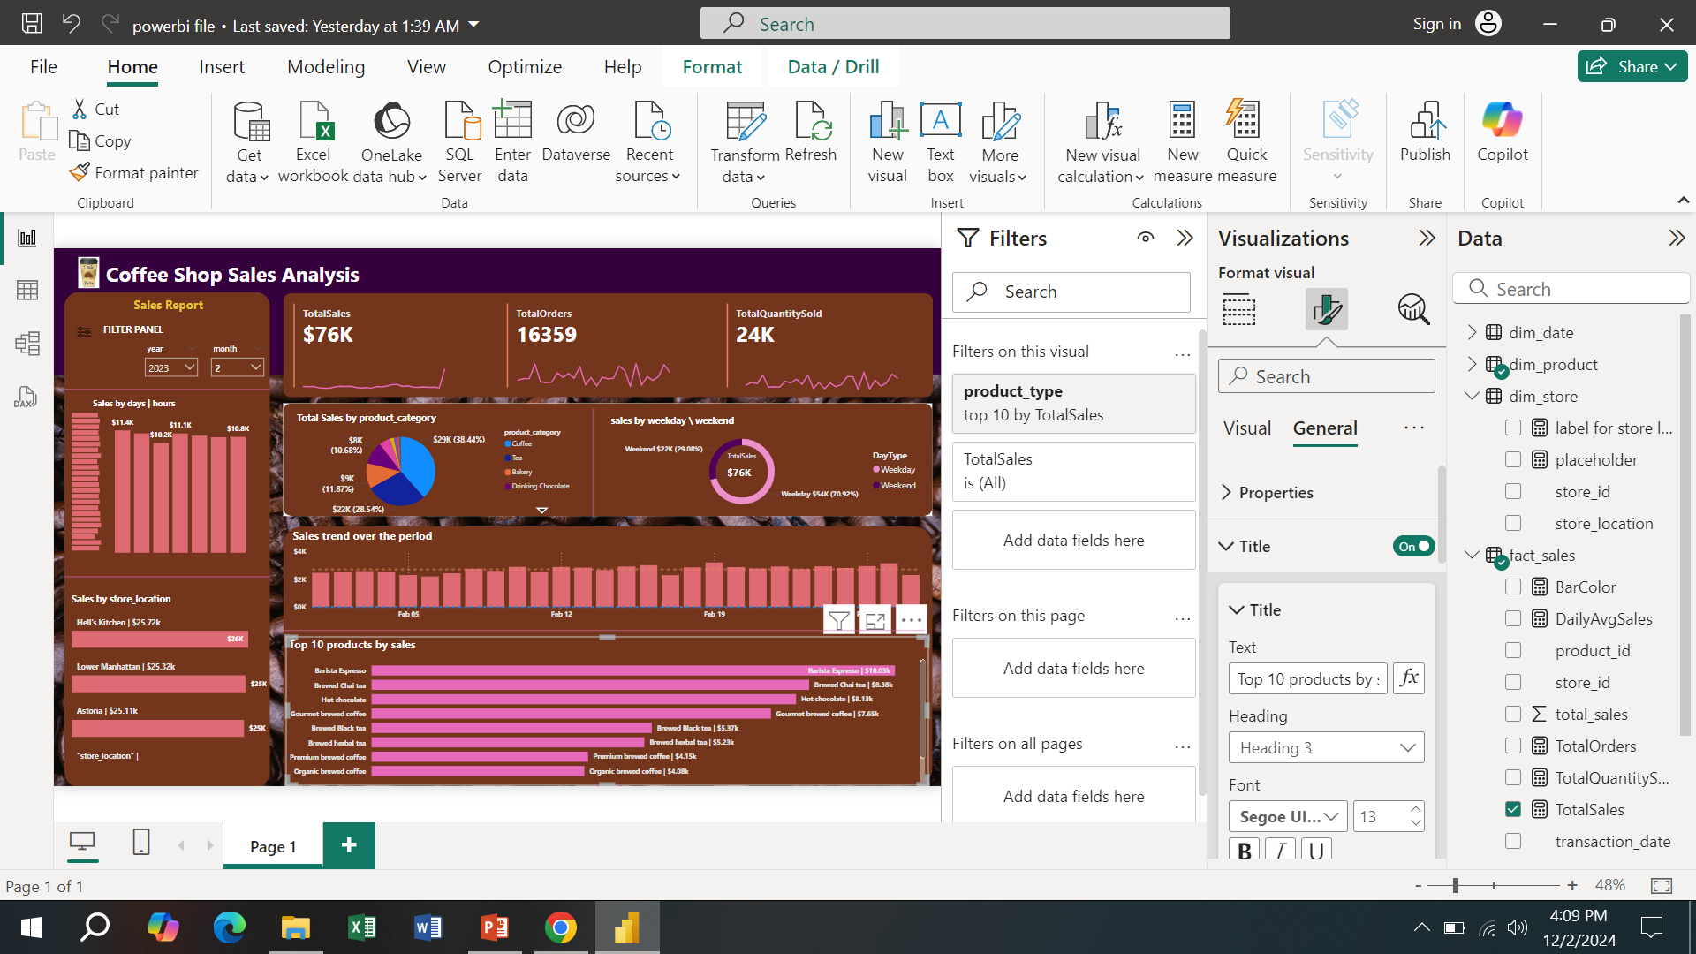

Slide 10
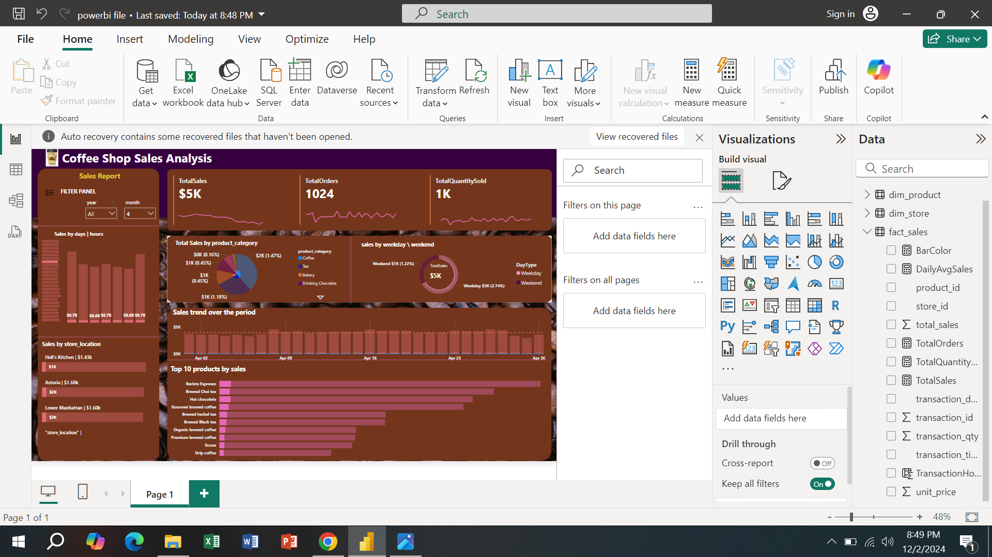

Slide 11
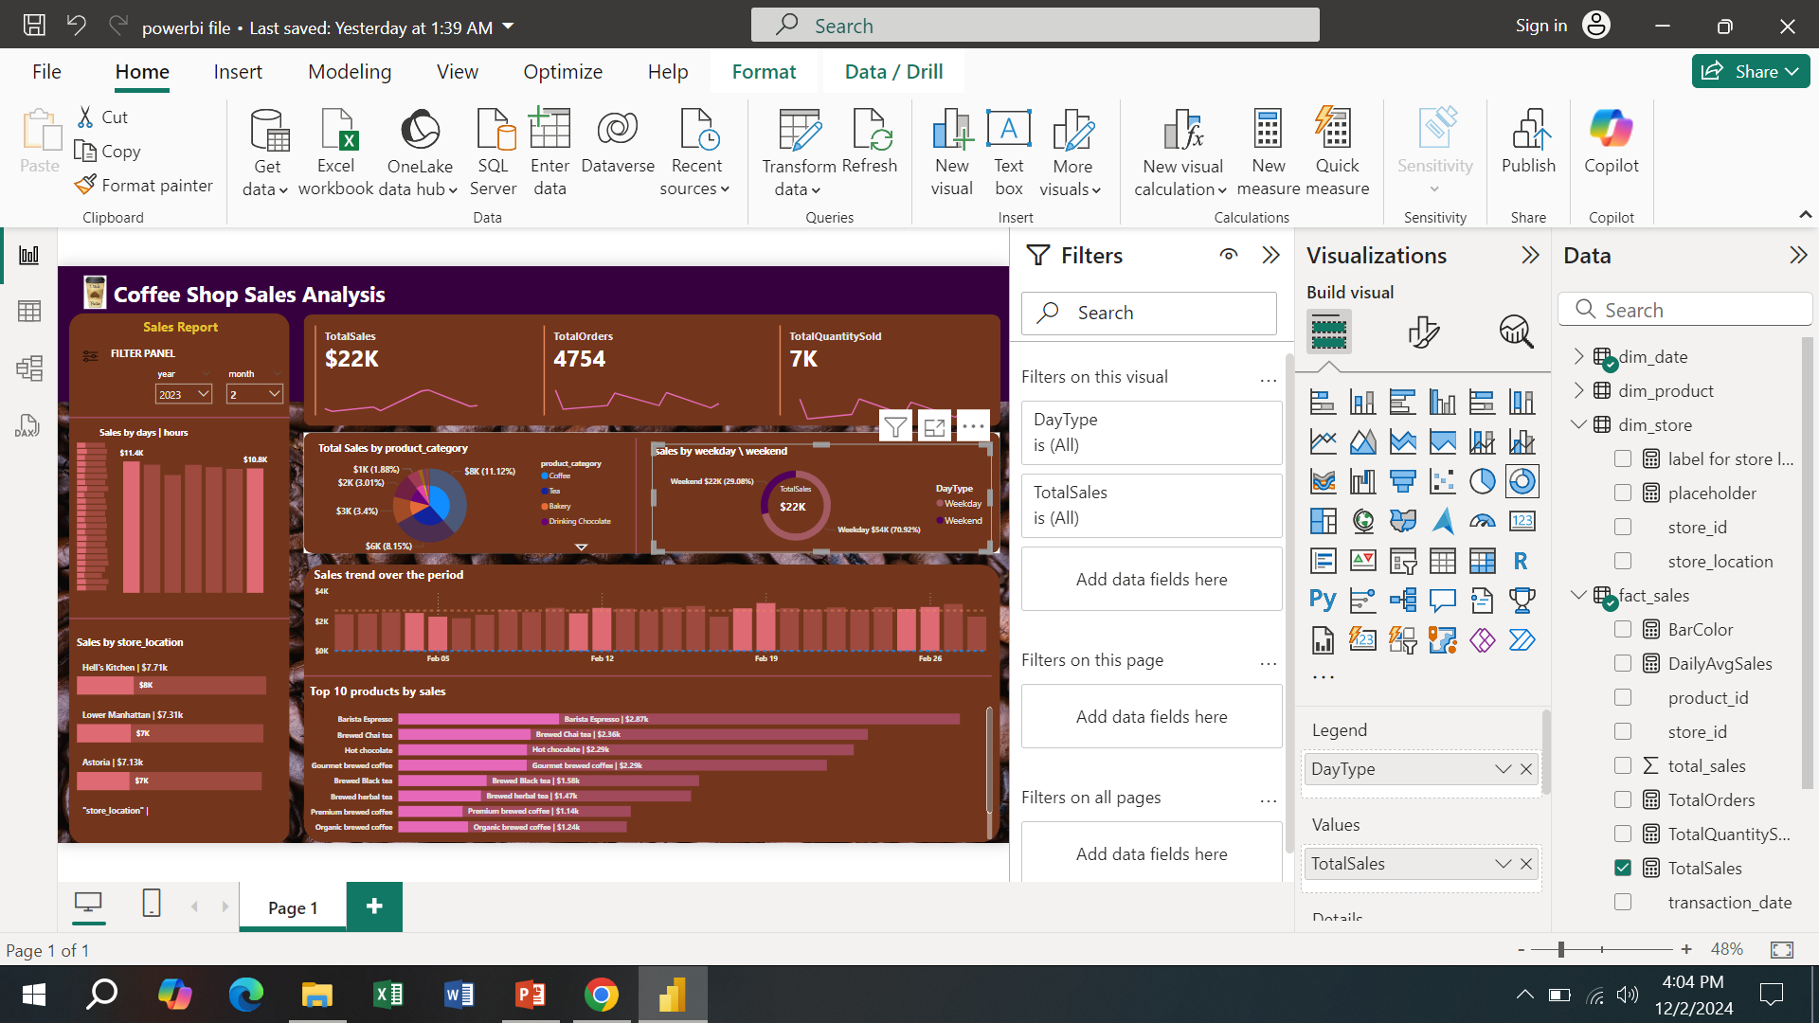

Slide 12
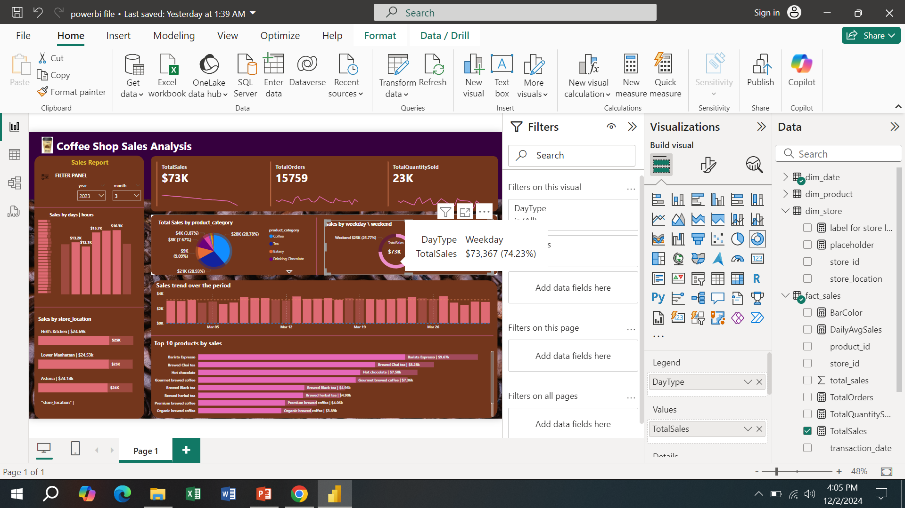

Slide 13
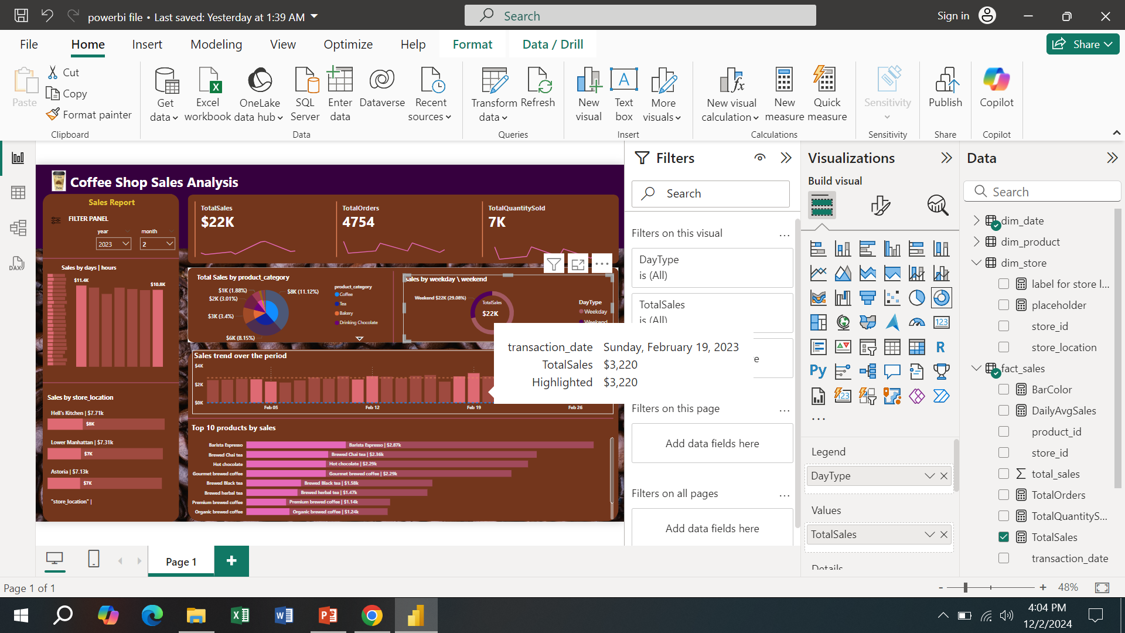

Slide 14
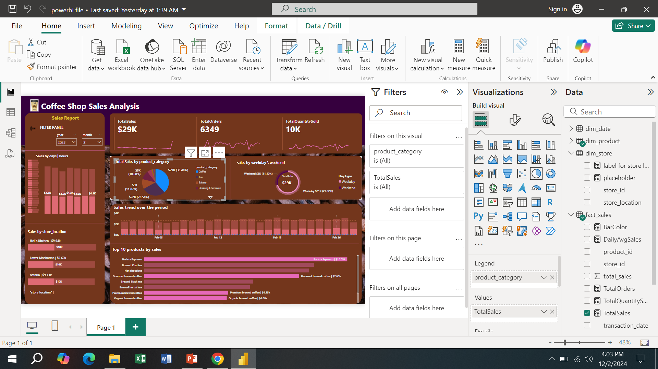

Slide 15
Key Insights:
Offering discounts significantly increases sales, especially during weekends and holidays.
The top 10 products contribute to the majority of sales.
Weekends show higher sales, suggesting promotional opportunities for these days.
Product Category Trends : Some categories (like beverages and food) perform consistently, while others (like accessories) show seasonal trends.

Slide 16
Slide 4
Recommendations:
Targeted Promotions: Run special weekend promotions to boost sales.
Inventory Management: Focus on stocking high-demand products to reduce out-of-stock situations.
Adjust Product Offerings: Based on sales by category, introduce more variety in the most popular categories.
Customer Loyalty Programs: Reward frequent buyers with discounts or exclusive products to encourage repeat purchases.

Slide 17
Slide 10
Conclusion :
This analysis provides key insights into sales performance, revealing customer preferences and trends at different store locations. By implementing these findings—like running targeted promotions, adjusting product offerings, and optimizing inventory management—the coffee shop can enhance customer satisfaction, increase sales, and improve operational efficiency.

Slide 18

Slide 15
THANK YOU!

